Slide 1
Logistics Optimization for Delivery Routes – DHL
Aditya Gawas Oct Batch

Slide 2
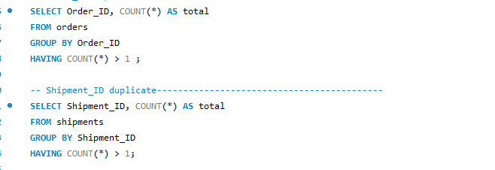

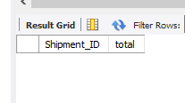
Task 1: Data Cleaning & Preparation
Identify and delete duplicate Order_ID or Shipment_ID records.
Output:

Slide 3

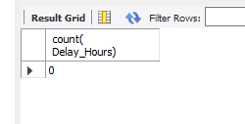
Replace null or missing Delay_Hours values in the Shipments Table with the average delay for that Route_ID
Output:

Slide 4
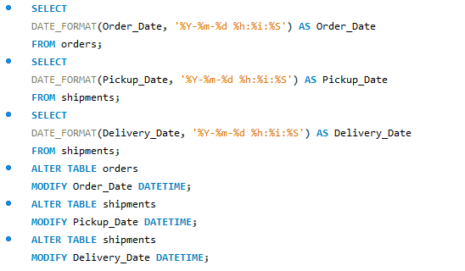
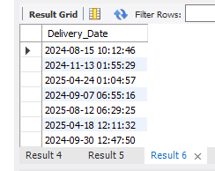
Convert all date columns (Order_Date, Pickup_Date, Delivery_Date) into YYYY-MM-DD HH:MM:SS format using SQL date functions.
Output:

Slide 5

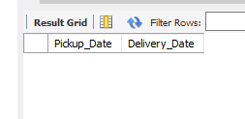
Ensure that no Delivery_Date occurs before Pickup_Date (flag such records).
Output:

Slide 6
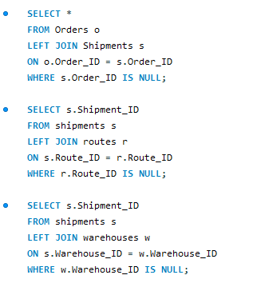
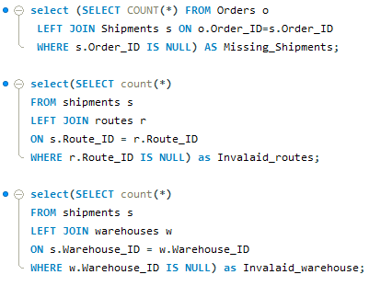
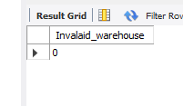
Validate referential integrity between Orders, Routes, Warehouses, and Shipments.
Output:

Slide 7
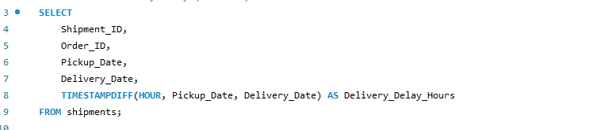
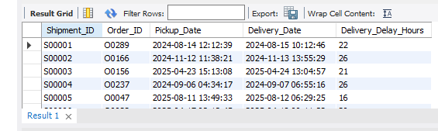
Task 2: Delivery Delay Analysis
Calculate delivery delay (in hours) for each shipment using Delivery_Date – Pickup_Date.
Output:

Slide 8
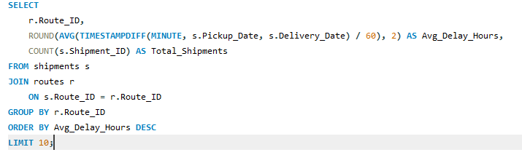
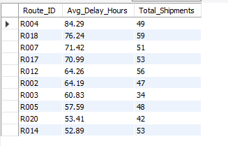
Find the Top 10 delayed routes based on average delay hours.
Output:

Slide 9
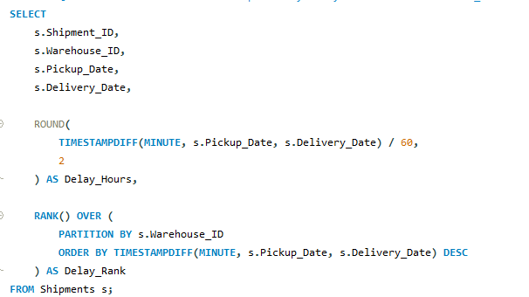
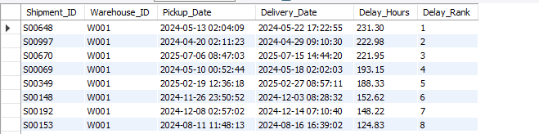
Use SQL window functions to rank shipments by delay within each Warehouse_ID.
Output:

Slide 10
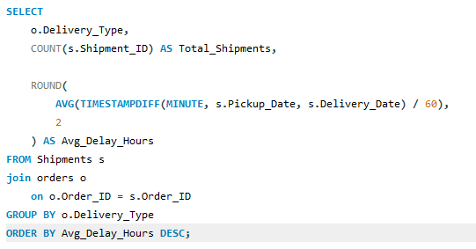

Identify the average delay per Delivery_Type (Express / Standard) to compare service-level efficiency.
Output:

Slide 11
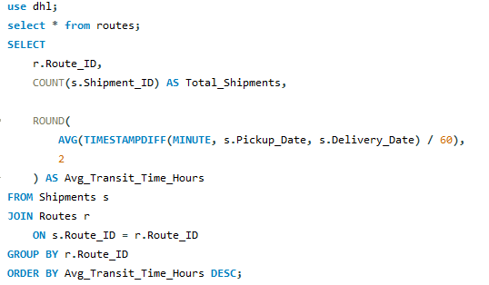
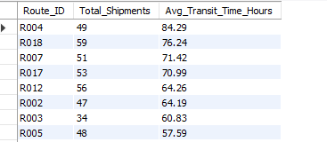
Task 3: Route Optimization Insights
Average transit time (in hours) across all shipments.
Output:

Slide 12
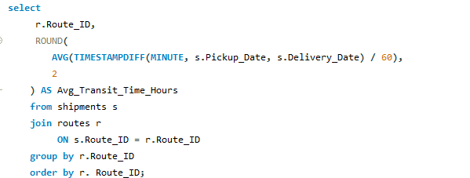
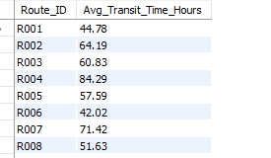
Average delay (in hours) per route.
Output:

Slide 13
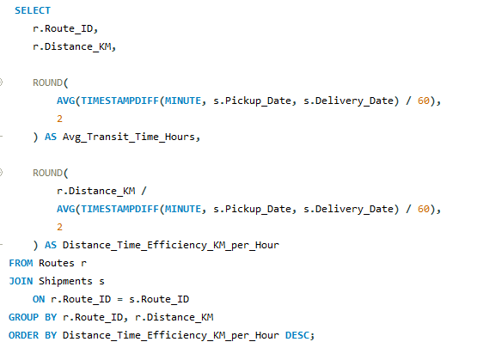
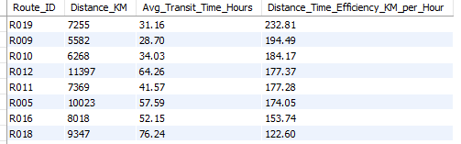
Distance-to-time efficiency ratio = Distance_KM / Avg_Transit_Time_Hours.
Output:

Slide 14
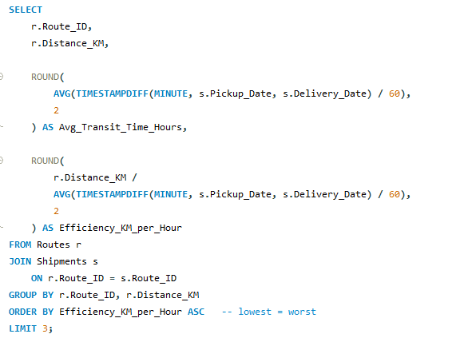

Identify 3 routes with the worst efficiency ratio (lowest distance-to-time).
Output:

Slide 15
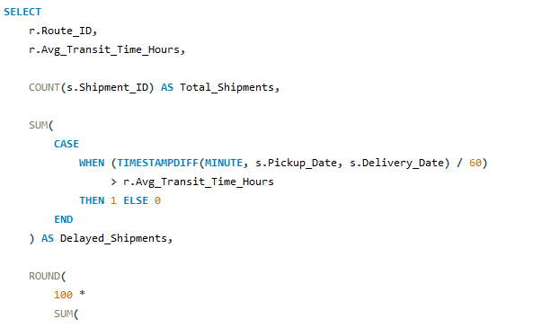
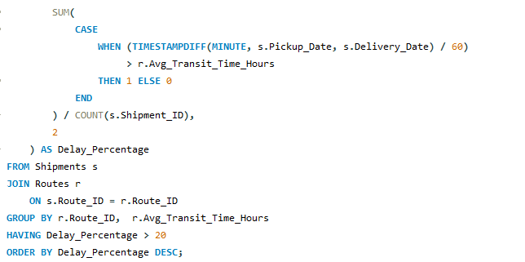
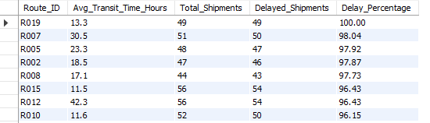
Find routes with >20% of shipments delayed beyond expected transit time.
Output:

Slide 16

Recommend potential routes or hub pairs for optimization.
Output:

Slide 17
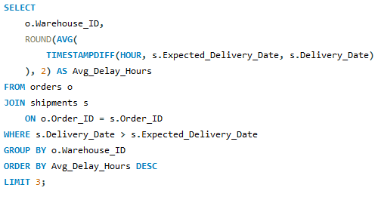

Task 4: Warehouse Performance
Find the top 3 warehouses with the highest average delay in shipments dispatched.
output:

Slide 18
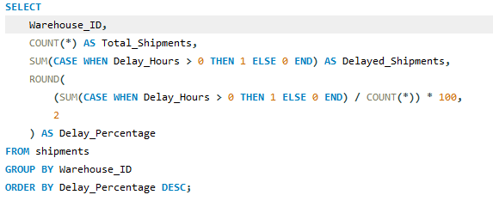
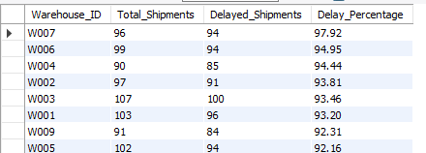
Calculate total shipments vs delayed shipments for each warehouse.
Output:

Slide 19
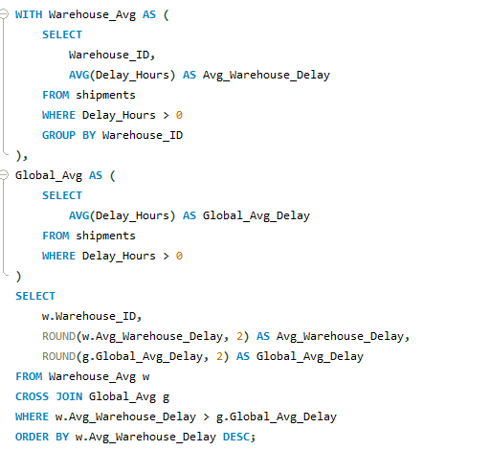
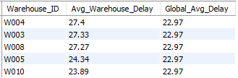
Use CTEs to identify warehouses where average delay exceeds the global average delay.
Output:

Slide 20
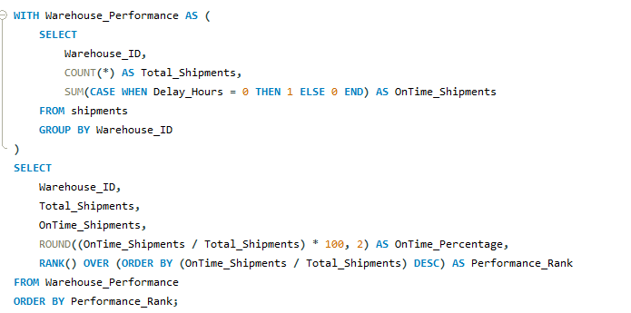
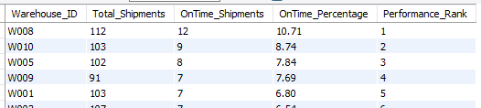
Rank all warehouses based on on-time delivery percentage.
Output:

Slide 21
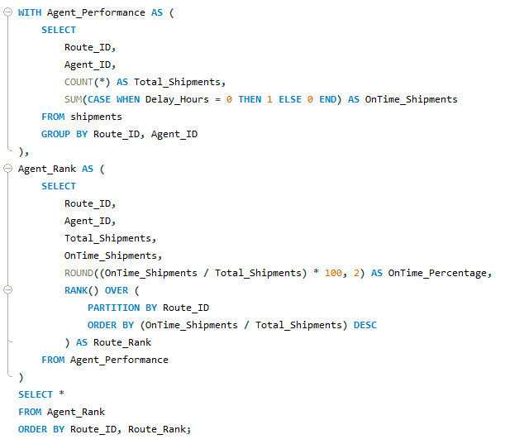
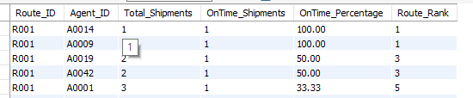
Task 5: Delivery Agent Performance
Rank delivery agents (per route) by on-time delivery percentage.
Output:

Slide 22
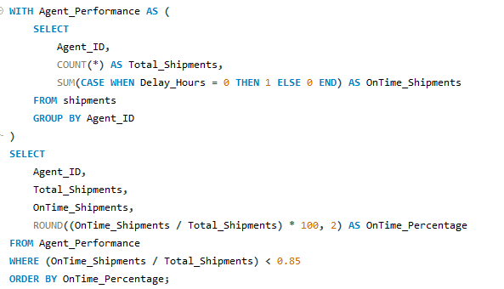
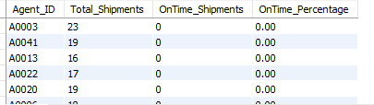
Find agents whose on-time % is below 85%.
output:

Slide 23
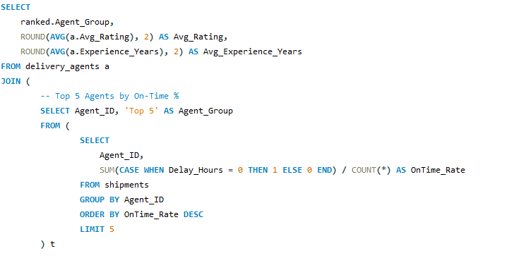
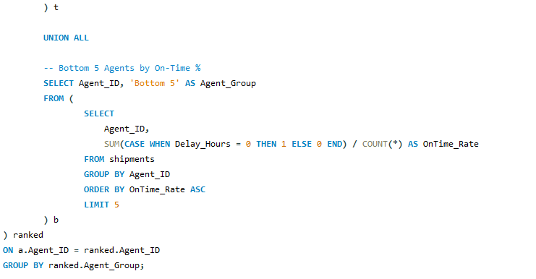

Compare the average rating and experience (in years) of the top 5 vs bottom 5 agents using subqueries.
Output:

Slide 24
Suggest training or workload balancing strategies for low-performing agents based on insights.
1. Identify why agents are underperforming
Low experience + high delays → Skill gap High experience + high delays → Overloaded routes Low rating + low on-time % → Customer handling or motivation issue
2. Training strategies
Pair low-performing agents with top agents for mentoring
Use top 5 agents to train bottom 5 agents Provide route-specific training for difficult routes Train agents on: Route planning Time management Customer handling
3. Workload balancing Assign long and high-volume routes to high-performing agents Assign simpler routes to low-performing agents Reduce daily shipment load for weak agents Increase shipment load for strong agents
4. Use ratings with performance Low rating + low on-time = high risk agent Put these agents on fewer and simpler deliveries Make training mandatory for them
5. Incentive-based improvement On-time > 95% → Bonus & priority routes On-time 85–95% → Normal workload On-time < 85% → Training + reduced workload

Slide 25
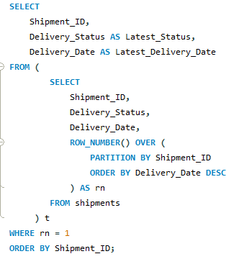
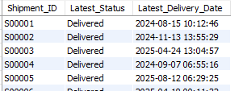
Task 6: Shipment Tracking Analytics
For each shipment, display the latest status (Delivered, In Transit, or Returned) along with the latest Delivery_Date.
Output:

Slide 26
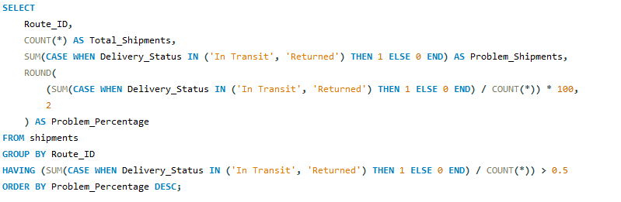
Identify routes where the majority of shipments are still “In Transit” or “Returned”.
Output:

Slide 27
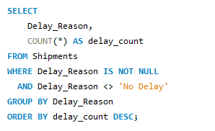

Find the most frequent delay reasons (if available in delay-related columns or flags)
Output:

Slide 28
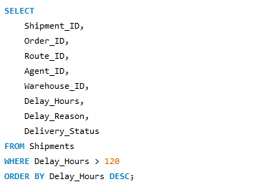
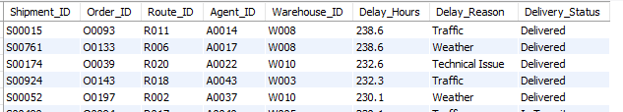
Identify orders with exceptionally high delay (>120 hours) to investigate potential bottlenecks.
Output:

Slide 29
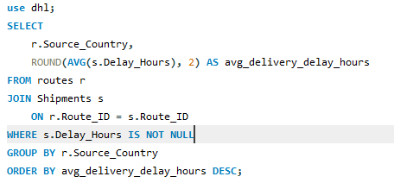
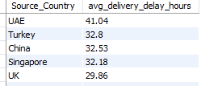
Task 7: Advanced KPI Reporting
Average Delivery Delay per Source_Country.
Output:

Slide 30
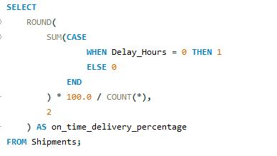

On-Time Delivery % = (Total On-Time Deliveries / Total Deliveries) * 100.
Output:

Slide 31
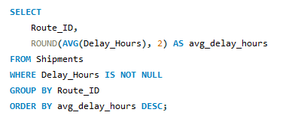
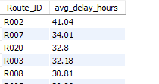
On-Time Delivery % = (Total On-Time Deliveries / Total Deliveries) * 100.
Output:

Slide 32


Warehouse Utilization % = (Shipments_Handled / Capacity_per_day) * 100.
Output:

Slide 33


Use aggregation and CASE statements to compute these metrics and create summarized KPI tables.
Output:

Slide 34
● Average Delay (in hours) per Route_ID.

Slide 35
Warehouse Utilization % = (Shipments_Handled / Capacity_per_day) * 100.

Slide 36
Video link
https://drive.google.com/drive/folders/1RQAXTthDQtY8cWedmcSgzskC1LynV9vn?usp=sharing
https://drive.google.com/drive/folders/1RQAXTthDQtY8cWedmcSgzskC1LynV9vn?usp=sharing

